Slide 1
Dynamic Query Formulation Using Ranking
Of Query Form Components

Slide 2
OBJECTIVE
Design a System which generates the query forms according to user’s desire at run time.

Slide 3
PROPOSED SYSTEM
This project proposes DQF, a novel database query form interface, which is able to dynamically generate query forms.
The essence of DQF is to capture user interests during user interactions and to adapt the query form iteratively.

Slide 4
Contd…(not needed)
The essence of DQF is to capture user interests during user interactions and to adapt the query form iteratively.
Each iteration consists of two types of user interactions: Query Form Enrichment and Query Execution.
The basic query form is then enriched iteratively via the interactions between the user and our system until the user is satisfied with the query results. In this paper, we mainly study the ranking of query form components and the dynamic generation of query forms.

Slide 5
EXISTING SYSTEM
Traditional query forms are designed and pre-defined by developers or DBA in various information management systems.
Therefore, it is difficult to design a set of static query forms to satisfy various ad-hoc database queries on those complex databases.

Slide 6
DISADVANTAGES(not needed)
Query forms are designed and pre-defined by developers in information management systems.
Difficult to design a set of static query forms to satisfy various ad-hoc database queries on complex databases.

Slide 7
PROPOSED SYSTEM(not needed)
We propose a dynamic query form system which generates the query forms according to the user’s desire at run time. The system provides a solution for the query interface in large and complex databases.
This paper proposes DQF, a novel database query form interface, which is able to dynamically generate query forms. The essence of DQF is to capture a user’s preference and rank query form components, assisting him/her to make decisions.
The generation of a query form is an iterative process and is guided by the user. At each iteration, the system automatically generates ranking lists of form components and the user then adds the desired form components into the query form. The ranking of form components is based on the captured user preference. A user can also fill the query form and submit queries to view the query result at each iteration. In this way, a query form could be dynamically refined till the user satisfies with the query results.

Slide 8
ADVANTAGES(not needed)
We propose a dynamic query form generation approach which helps users dynamically generate query forms.
The dynamic approach often leads to higher success rate and simpler query forms compared with a static approach.
The ranking of form components also makes it easier for users to customize query forms.

Slide 9
BLOCK DIAGRAM
User
Server
Not satisfied
Execute Query
Fill Query Form
View Result
Process result

Slide 10
Literature Survay(not ..)
1)A Case for a Collaborative Query Management System
NodiraKhoussainova, Magdalena Balazinska, Wolfgang Gatterbauer,
YongChulKwon, and Dan Suciu
New environments are emerging where large numbers of usersneed to develop and run complex queries over a very large, shared\ data repository. Examples include large scientific databases andWeb-related data. These users are not SQL savvy, yet they need to perform complex analysis on the data and are further constrained by the high cost of running and testing their queries, often on ashared server cluster.

Slide 11
2) Similarity Measures for Categorical Data: A Comparative Evaluation
ShyamBoriahVarunChandolaVipin Kumar
Department of Computer Science and Engineering In this paper we study theperformance of a variety of similarity measures in thecontext of a speci_c data mining task: outlier detection.Results on a variety of data sets show that whileno one measure dominates others for all types of problems,some measures are able to have consistently highperformance

Slide 12
3) USHER: Improving Data Quality with DynamicForms
Kuang Chen #1, Harr Chen _2, Neil Conway
In this paper, we have shown that probabilistic approachescan be used to design intelligent data entry forms that promotehigh data quality. USHER leverages data-driven insights toautomate multiple steps in the data entry pipeline. Beforeentry, we find an ordering of form fields that promotes rapidinformation capture, driven by a greedy information gain principle.During entry, we use the same principle to dynamicallyadapt the form based on entered values.

Slide 13
4) Automated Ranking of Database Query Results
Sanjay AgrawalMicrosoft Research
In this paper, we have presented our experience inattempting to build a generic automated rankinginfrastructure for SQL databases. This is consistent withour research philosophy of seeding the relational databasemanagement infrastructure with functionality necessaryand useful for data exploration.

Slide 14
5) SnipSuggest: ContextAwareAutocompletion for SQL
NodiraKhoussainova, YongChul Kwon, Magdalena Balazinska
In this paper, we present SnipSuggest, a system that provides onthe-go, context-aware assistance in the SQL composition process.SnipSuggest aims to help the increasing population of non-expertdatabase users, who need to perform complex analysis on theirlarge-scale datasets, but have difficulty writing SQL queries. As auser types a query, SnipSuggest recommends possible additions tovarious clauses in the query using relevant snippets collected froma log of past queries.

Slide 15
6) Probabilistic Information Retrieval Approach forRanking of Database Query Results
SURAJIT CHAUDHURI
Microsoft Research
We proposed a completely automated approach for the Many-Answers Problem which\ leverages data and workload statistics and correlations. Our ranking functions are basedupon the probabilistic IR models, judiciously adapted for structured data. We presentedresults of preliminary experiments which demonstrate the efficiency as well as the qualityof our ranking system

Slide 16
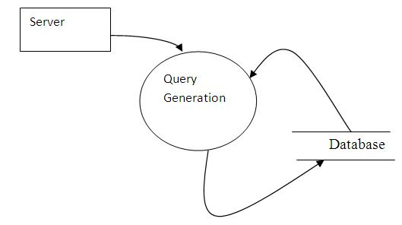
Data Flow Diagram
DFD-0

Slide 17
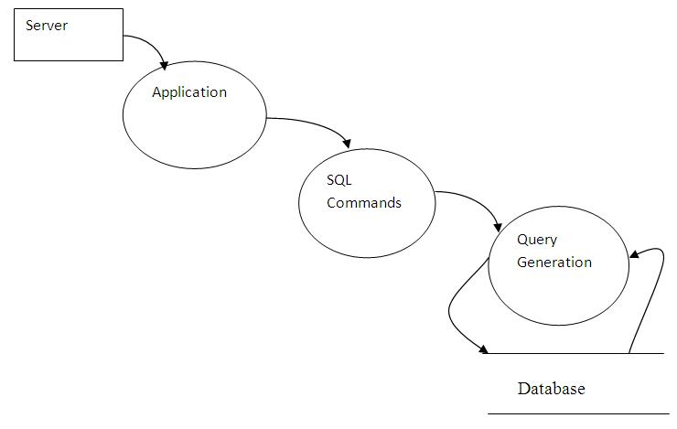
DFD-1

Slide 18
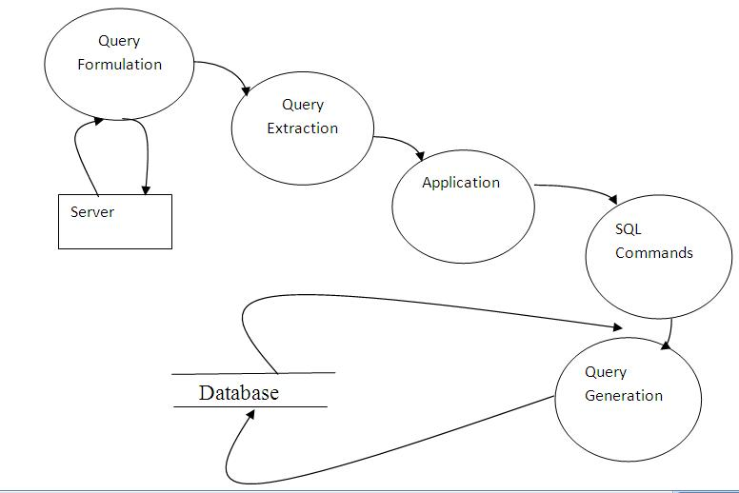
DFD-2

Slide 19
UML Diagram
Use case diagram

Slide 20
Class Diagram

Slide 21
Sequence Diagram( nn)

Slide 22
Collaboration Diagram:

Slide 23
Activity diagram☹nn)

Slide 24
ER-Diagram☹nn)

Slide 25
Modules
Query Form
Execute Query
Reconstruct QF

Slide 26
Query Form:
Designing the interface using JAVA Swing framework to enable interaction between the user and the database
To establish connection between the user desired database and the interface which helps in generating the query
This process is accompanied by allowing the user to select the appropriate entity and attributes
End User
Construct Query

Slide 27
Add Database:
Database contains the collection of dataset. These large databases are loaded to the Query form page. There are several types of Database drivers are available like Jdbc, Odbc and so on. Each database will be loaded to form and accessed with the help of these drivers. Novel user interfaces have been developed to assist the user to type the database queries based on the query workload, the data distribution and the database schema.
Large database
Query Form

Slide 29
Execute Query:
It first finds a set of data attributes, then that are retrieved based on the database schema and data instances. Then, the query forms are generated based on the selected attributes. The query forms are then generated based on those representative queries. If the database schema is large and complex, user queries could be quite diverse. In that case, the end-user can regenerate the query form and can execute that as a new query.
End User
Construct Query
Execute

Slide 30
Reconstruct QF
If the database schema is large and complex, user queries could be quite diverse. In that case, the end-user can regenerate the query form and can execute that as a new query. A solution is that the user inputs several keywords to find relevant query forms from a large number of pre-generated query forms. It works well in the databases which have rich textual information in data tuples and schemas.
Query result
Satisfied
End
Reconstruct Query

Slide 31
SOFTWARE REQUIREMENTS
Operating System :Windows 7
Language :Java, Swing
Database : MySql
Developing Tool : NetBeans 7

Slide 32
HARDWARE REQUIREMENTS
Main Processor : Above 2 GHz
Ram : 512 MB
Hard Disk : 80 GB
Platform : Windows 7 32bit

Slide 33
Future Work
As future work, we will study how our approach can be extended to non relational data.
we plan to develop multiple methods to capture the user’s interest for the queries besides the click feedback. For instance, we can add a text-box for users to input some keywords queries.
The relevance score between the keywords and the query form can be incorporated into the ranking of form components at each step.

Slide 34
Conclusion
In this paper we propose a dynamic query form generation approach which helps users dynamically generate query forms. The key idea is to use a probabilistic model to rank form components based on user preferences. We capture user preference using both historical queries and run-time feedback such as click through. Experimental results show that the dynamic approach often leads to higher success rate and simpler query forms compared with a static approach.

Slide 35
The ranking of form components also makes it easier for users to customize query forms. In this paper, we propose a Dynamic Query Form system: DQF, a query interface which is capable of dynamically generating query forms for users. Different from traditional document retrieval, users in database retrieval are often willing to perform many rounds of actions (i.e., refining query conditions) before identifying the final candidates. The essence of DQF is to capture a user’s preference and rank query form components, assisting him/her to make decisions. The generation of a query form is an iterative process and is guided by the user. At each iteration, the system automatically generates ranking lists of form components and the user then adds the desired form components into the query form.

Slide 36
REFERENCE
[1] Cold Fusion. http://www.adobe.com/products/coldfusion/.
[2] DBPedia. http://DBPedia.org.
[3] EasyQuery. http://devtools.korzh.com/eq/dotnet/.
[4] Freebase. http://www.freebase.com.
[5] C. C. Aggarwal, J. Han, J. Wang, and P. S. Yu. A framework for clustering evolving data streams. In Proceedings of VLDB, pages 81–92, Berlin, Germany, September 2003.
[6] R. Agrawal, S. Gollapudi, A. Halverson, and S. Ieong. Diver-sifying search results. In Proceedings of WSDM, pages 5–14, Barcelona, Spain, February 2009.
[7] S. Agrawal, S. Chaudhuri, G. Das, and A. Gionis. Automated ranking of database query results. In CIDR, 2003.
[8] S. Boriah, V. Chandola, and V. Kumar. Similarity measures for categorical data: A comparative evaluation. In Proceedings of SIAM International Conference on Data Mining (SDM 2008), pages 243–254, Atlanta, Georgia, USA, April 2008.

